Slide 1
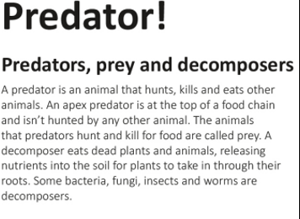
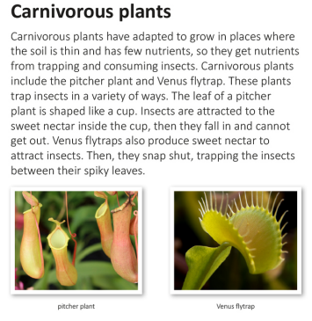
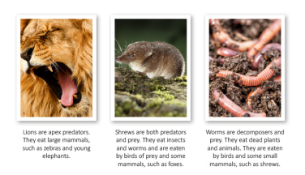
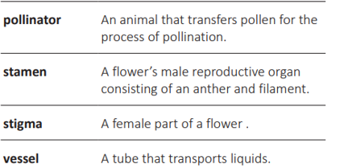
Glossary (Animals)
Adaption – A characteristic of a living thing that makes it suited to its environment and helps it to survive.
Ambush to suddenly attack something after hiding or waiting for it.
Camouflage – Ability to blend in with surroundings.
Mammal – A warm blooded animal with a backbone whose body is usually covered in hair or fur.
Stalk – to follow an animal without being seen or heard.
Nectar – A sweet liquid produced by flowers and collected by insects.

Slide 2
