Slide 1

Growth Mindset
Communication
Resilience
High Aspirations
Self-Aware
Teamwork
Positivity
Happiness
Excellence
Personal Development
Independence
Citizenship
British Values
SMSC
RE
PSHE
RSE
Character Development

Slide 2

Personal Development Vision
Children have opportunities throughout their time at Ratby Primary School to have rich and varied experiences.
● Regardless of their background, children develop their ‘cultural capital’ while at Ratby
● Physical and mental well-being are prioritised as much as academic achievements
● Families involved where possible, to support all areas of their child’s personal development

Slide 3

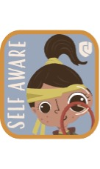

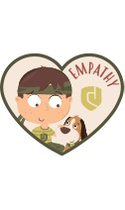

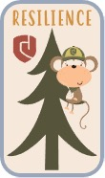

Our Values

Slide 4
Wider Opportunities
Development of Character
RSHE – Sex and Relationships Education
SMSC
RSHE- Physical & Mental Well-Being
Personal Development Curriculum
British Values
Citizenship
Protected Characteristics
Inclusion & Equal Opportunities

Slide 5

RSHE: Sex and Relationship Education
Children are support to stay safe
Experienced PSHE Lead
PSHE Lead attends Trust Network Meetings
National College Advanced Certificate in the role of RHSE/PSHE Lead
Twinkl Scheme of Work linked to EYFS PSE Curriculum
Catherine Kirk – LA Specialist Support for RHE
Consulted with parents and staff
Linked to Computing – E-Safety units
Review of Programme of study includes feedback from parental survey and taking into account the changing needs of pupils. e.g RSE unit now taught in Autumn 2
RSE accessible to all
A degree of flexibility to respond to contextual issues that may arise or need to be revisited.
Whole School Training on LGBTQ+ Awareness and Inclusion for Primary Schools
Development for 23-24 – Everyone’s Welcome
Children with SEND are supported to learn the information they need with appropriate adult support.
Children from EYFS onwards are taught about consent and to use correct terminology for parts of the body
5 Ways to Well-Being Y6
Parent Consultation undertaken
LA Training undertaken
RSE part of Autumn curriculum to fill in gaps in missed learning
Cohesive and progressive scheme to work EYFS to Y6
Established PSHE Lead
Physical and Mental Well-Being
Speak out Stay Safe
Internet Safety Day
Links to Computing online safety units

Slide 6
RSHE: Physical and Mental Well-Being
PSHE Curriculum: It’s My Body unit Y1,Y3,Y4 (healthy eating, physical health and fitness, oral hygiene, sleep and its benefits, risk of drugs and alcohol, storing of medicine, personal hygiene, making healthy choices, how children think and feel about their body )
PSHE Curriculum: Being Positive Y2/Y4/Y5
PSHE Curriculum: Team Y1/Y3/Y5
PSHE Curriculum: Aiming High Y1/Y3/Y5
Well-Being Wednesday’s - 10 Keys to Happiness
Basic First Aid – St. John’s Ambulance (Year 6)
Command Joes - RESPECT
Transition (Early Years and Years 6 and Mid Year Transfers)
Pastoral Lead and 6 ELSAs
School Counsellor
Growth Mindset (Shirley Clarke) units at the start of each year
Happy Lunchtimes
Celebration Assembly
Peer Stars
Anti-Bullying Ambassadors
Mental Health Lead Training using ROAR
Mental Health First Aider Training
Children’s Mental Health Week
Pupil Surveys
Speak Out Stay Safe
Sollihull Parenting Course for Parents
Pastoral Lead delivers Y5 Think Wise Programme
Forest School - Muddy Buddies

Slide 7
Citizenship
PSHE Curriculum: Diverse Britain Y1/Y3/Y5
PSHE Curriculum: One World Y2/Y4/Y6
PSHE Curriculum: Money Matters Y2/Y4/Y6
PSHE Curriculum: Aiming High Y1/Y3/Y5
Applications for Roles in school: School Council, House/Vice Captains, Peer Stars, Anti-Bullying Ambassadors, Reading Ambassadors, Subject Ambassadors,
Opportunities for democracy: Voting for candidates for House/Vice Captains and School Council Reps
Pupil Questionnaires
School Council
Y6 Opportunity to write to local MP
Links to English Curriculum – Persuasive units of work
Y6 Visit to Warning Zone to look at Social Responsibilities
Visitors to School

Slide 8
Development of Character
RESPECT Programme with Commando Joes: Resilience, Excellence, Self-Aware, Positivity, Empathy, Communication, Teamwork
Colours Monsters in EYFS
Growth Mindset
10 Keys to Happiness
Wider Opportunities
Extra Curriculuar Opportunities including Clubs
Sense of belonging and pride of belonging to Ratby Primary School

Slide 9
Wider Opportunities
Educational Visits and Residentials
Competitions – Art – Stamp for Queen’s Jubilee, Show Racism the Red Card, Y6 Talk the Talk, Autism Art, STEM Challenges,
Y5 Young Voices
Commando Joes
Launch Days
Visitors to School
Community Events – Scarecrow Event,
Extra Curriculuar Opportunities
Muddy Buddies
Visits to other schools
Y5 Bikeability
Fund-Raising Events: Parent Staff Association, Children in Need, Macmillian Coffee Morning, Syria & Turkey Earthquake Appeal, Oxfam Unwrapped, Ukranian Day
Pupils leading assemblies e.g Remembrance, Christmas Service, Y6 Leavers Assembly
Happy Lunchtimes
Clubs accessible to all children
Sporting Competitions
SEND Provision – Bubble Run, New Age Kurling,

Slide 10
SMSC
Spiritual
  10 Keys to Happiness
  Commando Joes
  PSHE Curriculum: VIPs. Y1/Y3/Y5, One World Y1/Y3/Y5 , Diverse World Y1/Y3/Y5
  Links with other schools
  Peer Stars
  Rewards and Praise
  Assemblies
  Visits to place of worship
  Easter/Christmas/Harvest Services in school
  Themed afternoons
  Educational visits that inspire awe and wonder – Y6 Cathedral, Y3 Sealife Centre, Y5 Young VoicesY1 Space Centre
  Residentials
  RE Curriculum
Moral
PSHE Curriculum
British Values Assemblies and Lessons – Rule of Law
School Vision
Assemblies / Collective Worships
Visitors – e.g Police, Diversity Team, AOB Busters, NSPCC, Fire Safety,
Charity Themed Days – Oxfam Unwrapped, Show Racism the Red, Children in Need, Ukraine Day, Syria Turkey Earthquake Appeal, Macmillian Coffee Mornings
School Behaviour Policy and School Rules
Class Charters
Anti-Bullying Policy and Ambassadors
E-safety units and Internet Safety
Protected Characterstics
School Council Training

Slide 11
SMSC
Social
  British Values
  Transition Events for EYFS/Y6
  Sports Day
  Education Visits
  Local events involving other primary schools
  Pupil Voice
  Supporting the local community – Coffee Mornings, PSA Disco, Film Clubs, Remembrance Day , Scarecrow Festival
  Happy Lunchtimes
Cultural
  Links to inner-city school in Leicester
  Art Competitions
  Sport Stars Visitors
  Appreciation of Music
  Geography – The World this Week
  Wider Opportunities
  Theatre Trip
  Inspirational Visitors
  Inter-School Evnts
  Themed Days/Weeks
  Whole School Curriculum Y5 Hola Mexico/Y3 Road Trip USA / Y6 Frozen Kingdom
  Y6 Enterprise
  Y5 Garden Classroom – Y5 Allotment

Slide 12
British Values
Individual Liberty
  PSHE Curriculum: One World Y2, Y4, Y6
  PSHE Curriculum: Aiming High Y1,Y3, Y5
  PSHE Curriculum Diverse Britain Y1,Y3, Y5
Playground Buddies
Rights Respecting School – Bronze
Peer Stars/Anti-Bullying Ambassadors
Fund Raising
Rule of Law
  PSHE Curriculum Diverse Britain Y1,Y3, Y5
  School Behaviour Policy: Positive and Negative Consequences
  School Rules
  School Charter
  Behaviour Policy
  ASB Busters
  Warning Zone
  Fire Service
  Police – Diversity and Inclusion for KS2
Tolerance and Respect
  PSHE Curriculum Diverse Britain Y1,Y3, Y5
  RE Curriculum
  Shenton Primary School (Leics City) link
  Visits to place of worship Programme
Democracy
  PSHE Curriculum: One World Y2, Y4, Y6
  PSHE Curriculum Diverse Britain Y1,Y3, Y5
  History Curriculum: Romans Democracy, Greek Democracy
  History Curriculum: Romans Democracy, Greek Democracy
  Voting for House/Vice Captains, School Council Reps

Slide 13
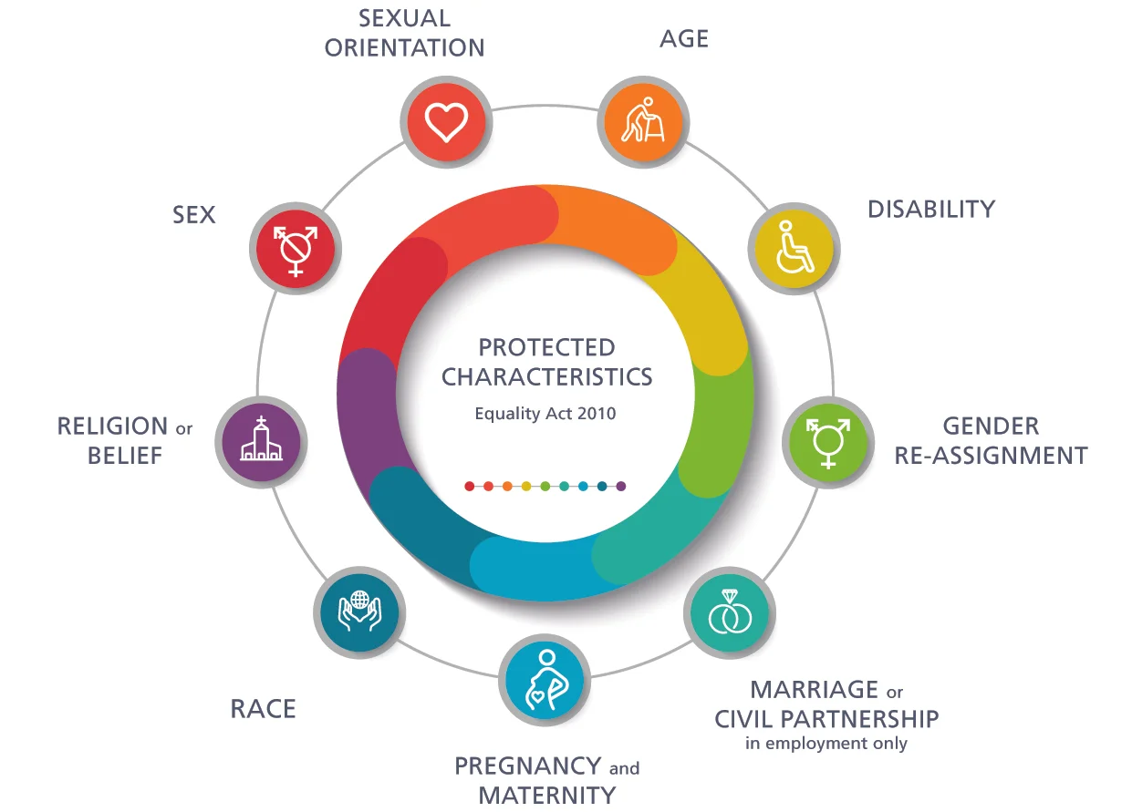
Orientation
PSHE units aiming high – jobs for all/stereotypes when I grow up
PSHE unit – Growing up just the way you are
PSHE unit – One world families home and school
Equality – One world
Assemblies
Antibullying
LGBT staff training
Everyone welcome (2023)
PSHE units aiming high – stereotyping of jobs
RSE girls and boys differences
Pink and Blue lesson in its my body addresses stereotypes
Challenge stereotypes in RSE
Women’s day activity (2022)
Families as part of RSE
Age
Age UK
Getting Older and growing up
Aiming high – When I am older
Disabilities
Celebrating differences in PSHE
Be yourself – pride/identity/uniqueness
Assemblies
PSHE – LGBT within year 6
PSHE it’s my body and Growing up – Just the way you are and relationships
PSHE – Be yourself being unique
Think positive – overcoming challenges
VIP opinions in a respectful way
2024 forward – toilets to be changed on school?
Staff LGBT training
Religion
PSHE unit Diverse Britain and One World
RE Twinkl planned units
Visits to places of worship
Links with interfaith schools
Celebrating diversity in school through assemblies
Themed Festival days
Race
Diverse Britain
One World
SRtRC
Diversity and inclusion visits
Anti bullying
Links with interfaith schools
Marriage
RSE – Growing up unit families/loving relationships

